Slide 1

Unpacking Before the Move
Investigating the Social and Commercial Pulse of a Town
Before a Big Move
Data Science Capstone Project
By Colette Campbell

Slide 2
The Question:
Moving is considered one of the top five most stressful life events.
Can data science be used to help alleviate that stress?

Slide 3
The problem:
A friend of mine and her husband are considering a move to Avon, Connecticut within the next year or two. Having never been there, they have questions:
What type of venues are in Avon?
Are there a variety of restaurants?
Which stores are available for shopping?
Are there other towns similar to Avon that offer a similar social and cultural experience?

Slide 4
The Answer:
Yes, data science can be used to help inform my friend before the move.
Using a combination of data from the internet, Foursquare venue information, and K-Means Clustering, I can answer my friend’s questions.

Slide 5
Data was acquired by:
Scraping the web
Using geopy for geographical coordinates of locations of interest
Using Foursquare to obtain information on venues

Slide 6
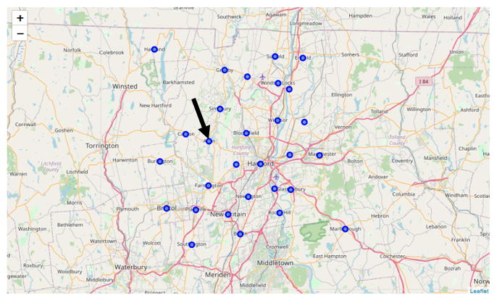
Map of Hartford County
From the data collected, a map showing Hartford County, Connecticut and its 29 towns was created. The arrow is pointing to the town of Avon.

Slide 7
Hartford County’s Top Ten and K-Means Clustering
The K-Means Clustering was the method of analysis used to compare the top ten most common venues in each town located in Hartford County.
K-means clustering is a method used to take a data set and group similar cases.
When employing this technique, it is necessary to specify the number of clusters (k).
The most popular method to identify the optimal value of “k” is “The Elbow Method”.

Slide 8
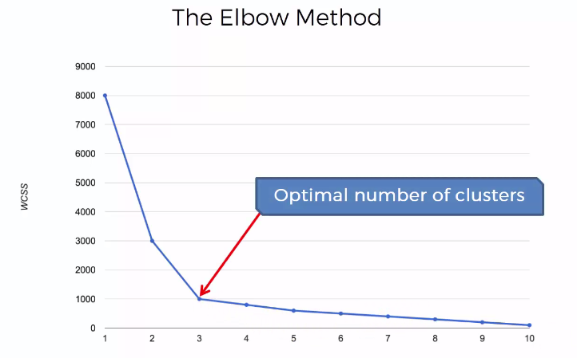
The Elbow Method
In this method, one wants to minimize the distance between points in a cluster (measured using the total within-cluster sum of squares, or WCSS). The total WCSS is a measure of the compactness of a cluster. When a graph of WCSS versus number of clusters is made, an “elbow” is formed at the optimal value of “k”.
Source of graphic:
https://arun-aiml.blogspot.com/2017/07/k-means-clustering.html

Slide 9
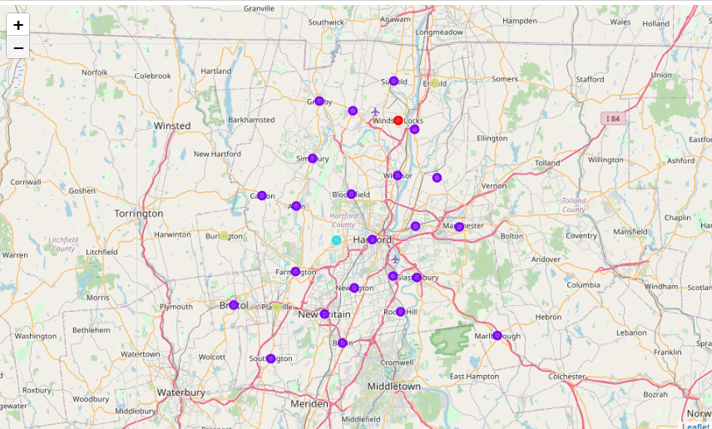
Map of Clusters
The map to the right shows the towns in Hartford County.
Each town is assigned a colored marker according to the assigned cluster.
The red marker indicates Cluster 1.
The purple marker indicates Cluster 2.
The aqua marker indicates Cluster 3.
The green marker indicates Cluster 4.

Slide 10
Results
This set of data did not offer much variation. Many of the towns have similar venues listed in their top 10. Adding demographic information for each town would help to distinguish the clusters.

Slide 11
Response to “the problem”
Based on the Analysis

Slide 12
What type of venues are in close proximity to the town (Avon)?
Within the small radius of 500-m of the town center of Avon, there are many types of venue including:
restaurants
coffee shops
a furniture store
a juice bar
a barre studio
a sporting goods shop

Slide 13
Are there a variety of restaurants in Avon?
Avon has many different types of restaurants including (but not limited to):
Italian
American
Thai
Korean
Seafood.

Slide 14
Which stores are available for shopping in Avon?
The only stores returned in the small area of exploration were a shipping store and a sporting goods store. When examining the top 10 most common venues, the results practically mirror the stores found within 500-m of the town center. This would suggest that a resident of Avon may have to travel outside of the town limits for a variety when shopping.

Slide 15
Are there other towns similar to Avon that offer a similar social and cultural experience?
Based on the top 2 most common venues, the town of Canton would be considered most similar to Avon.
Avon appears to be unique in that no other town has a juice bar or furniture store listed in their top ten most common venues.

Slide 16
Conclusion
Many of the towns in Hartford County, Connecticut have similar venues available to residents.
The town of Canton seems to be most similar to Avon based on the top venues in each town.
To better distinguish between the towns in Hartford County, the analysis could be done again including demographics for each town.

